Slide 1

Comparing
Technical Indicators
By Sarah

Slide 2

Objective
The objective of this presentation is to evaluate and compare the performance of two trading strategies that combine popular indicators with the Relative Strength Index (RSI).
Specifically, we will examine the effectiveness of combining the Exponential Moving Average (EMA) with RSI and the Moving Average Convergence Divergence (MACD) with RSI.
The aim is to determine which strategy demonstrates superior performance in identifying potential trend reversals, generating accurate trading signals, and maximizing profit potential.
By analyzing historical data and key performance metrics, we seek to provide insights into the effectiveness of these combined strategies and their potential value in enhancing trading decisions.

Slide 3
Let's begin by discussing the strategy that combines the Exponential Moving Average (EMA) with the Relative Strength Index (RSI).
EMA: The EMA is a trend-following indicator that provides a smoothed line representing the average price over a selected time period. By combining the EMA with RSI, we can benefit from the EMA's ability to identify trends while leveraging the RSI's overbought and oversold conditions as potential reversal points.
RSI: The RSI is a momentum oscillator that measures the speed and change of price movements. It indicates whether an asset is overbought or oversold, potentially signaling a trend reversal. Combining RSI with EMA helps confirm potential reversals identified by the EMA and enhances the timing of trade entries or exits.
We will analyze historical price data and evaluate the success rate, average profitability, and risk-to-reward ratio of this combined strategy to determine its effectiveness.
Overview of the EMA and RSI Combination Strategy

Slide 4
Now, let's compare the performance of EMA and MACD in identifying reversals when combined with the RSI . We will analyze historical price data and assess the accuracy of each indicator in predicting price reversals.
Data Selection: We will use the SPY and select a substantial time period to ensure reliable results.
Evaluation Criteria: We will consider factors such as the reversal signals, and the magnitude of price movements following the signals.
Statistical Analysis: We will employ appropriate statistical measures, such as actual returns vs strategy returns, cumulative returns vs cumulative strategy returns, and sharpe ratio, to quantitatively assess the performance of EMA and MACD.
Performance Comparison of EMA and MACD

Slide 5

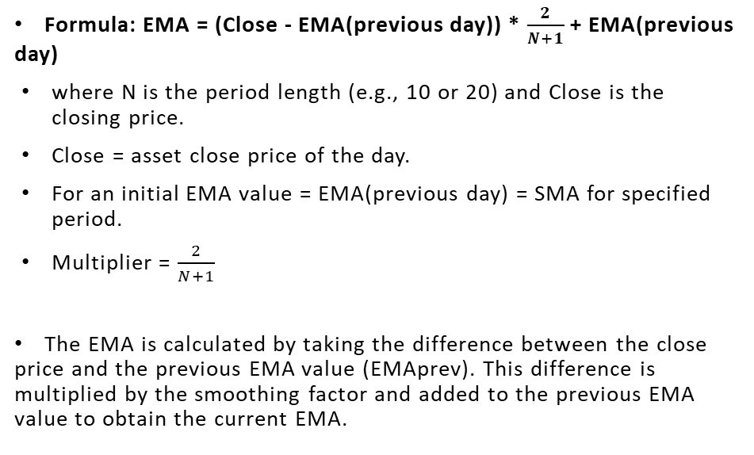
EMA formula

Slide 6
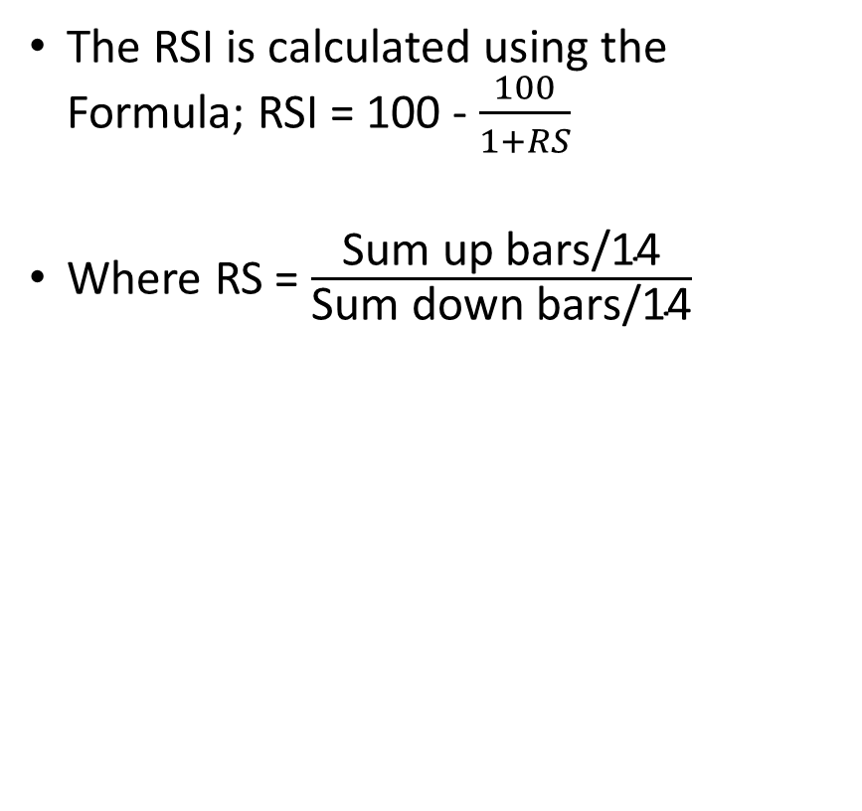
RSI Formula

Slide 7
Defining First Entry and Exit Condition
Buy Entry: When the 10 period EMA is > 20 period EMA
Exit: The RSI is <= 50.
Sell Entry: When the 10 period EMA is < 20 period EMA
Exit: The RSI is >= 50.

Slide 8
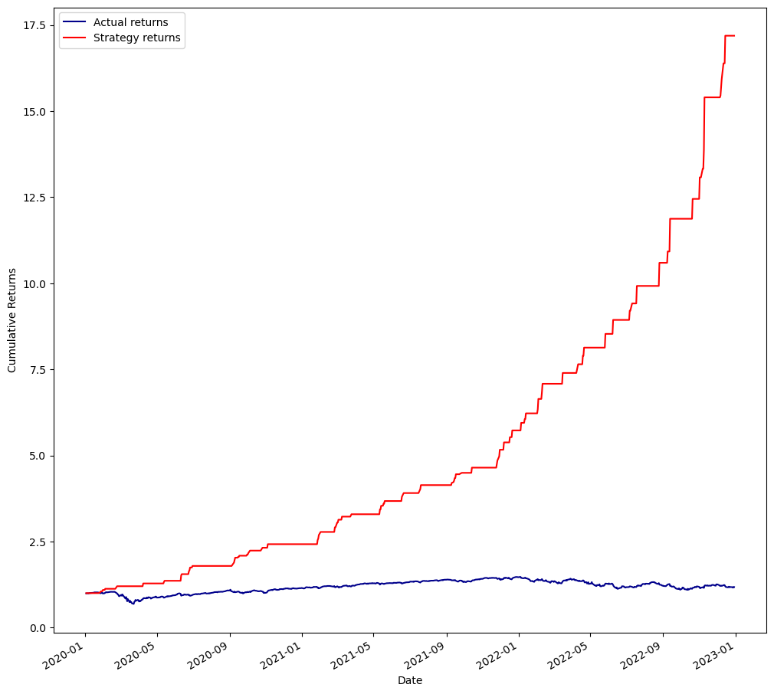
Backtest Result

Slide 9
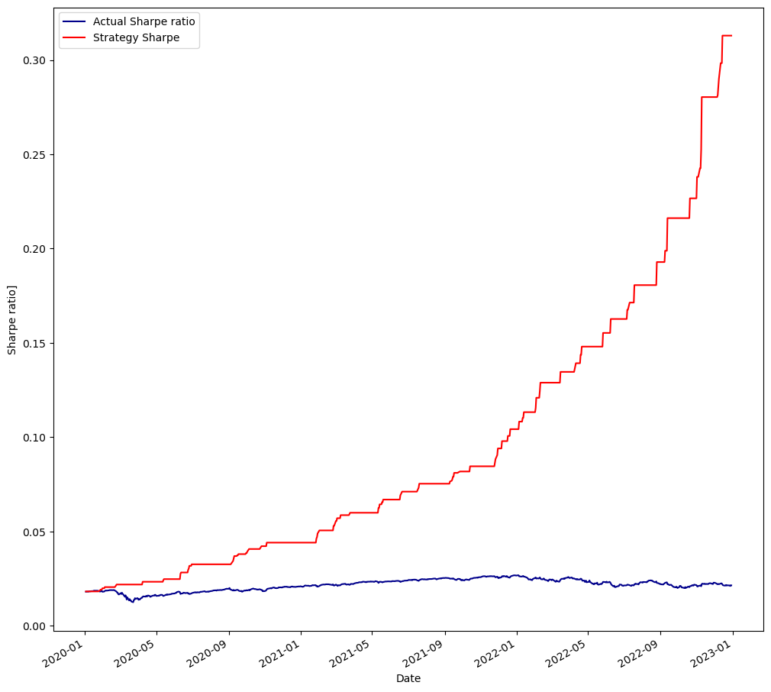
Sharpe Ratio Result

Slide 10





Defining Second Entry and Exit Condition
Buy Entry: When the 10 period EMA is > 20 period EMA
Exit: The RSI is <= 70.
Sell Entry: When the 10 period EMA is < 20 period EMA
Exit: The RSI is >= 30.

Slide 11
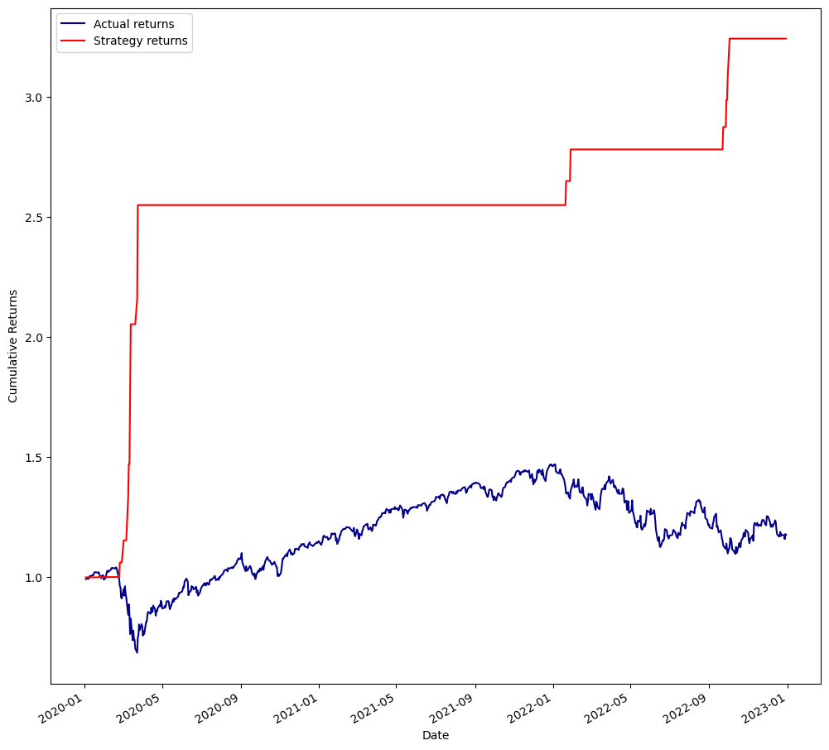
Backtest Result

Slide 12
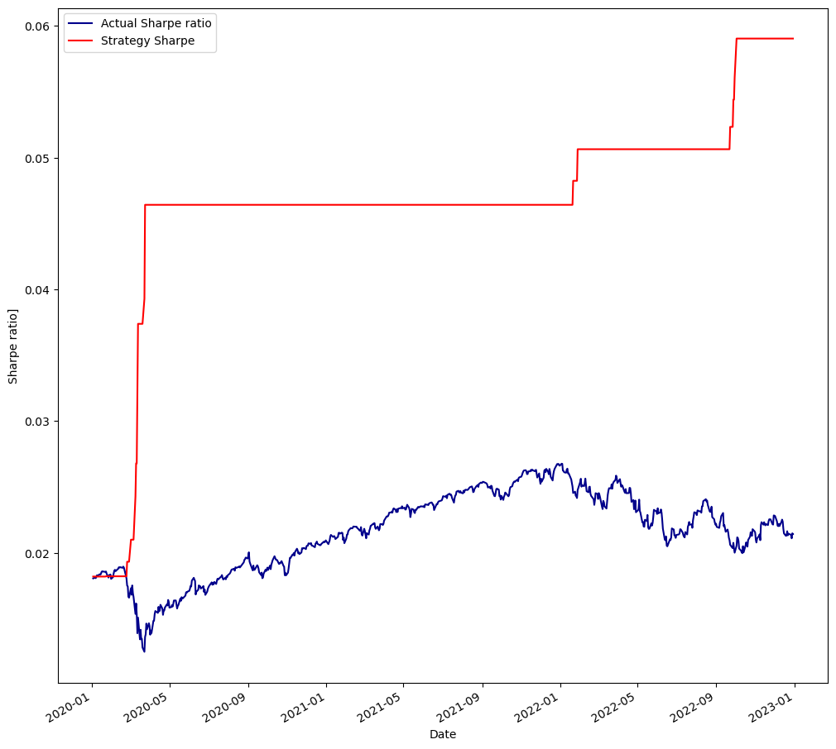
Sharpe ratio Result

Slide 13
Defining Third Entry and Exit Condition
Buy Entry: When the 10 period EMA is > 20 period EMA
Exit: The RSI is <= 30.
Sell Entry: When the 10 period EMA is < 20 period EMA
Exit: The RSI is >= 70.

Slide 14
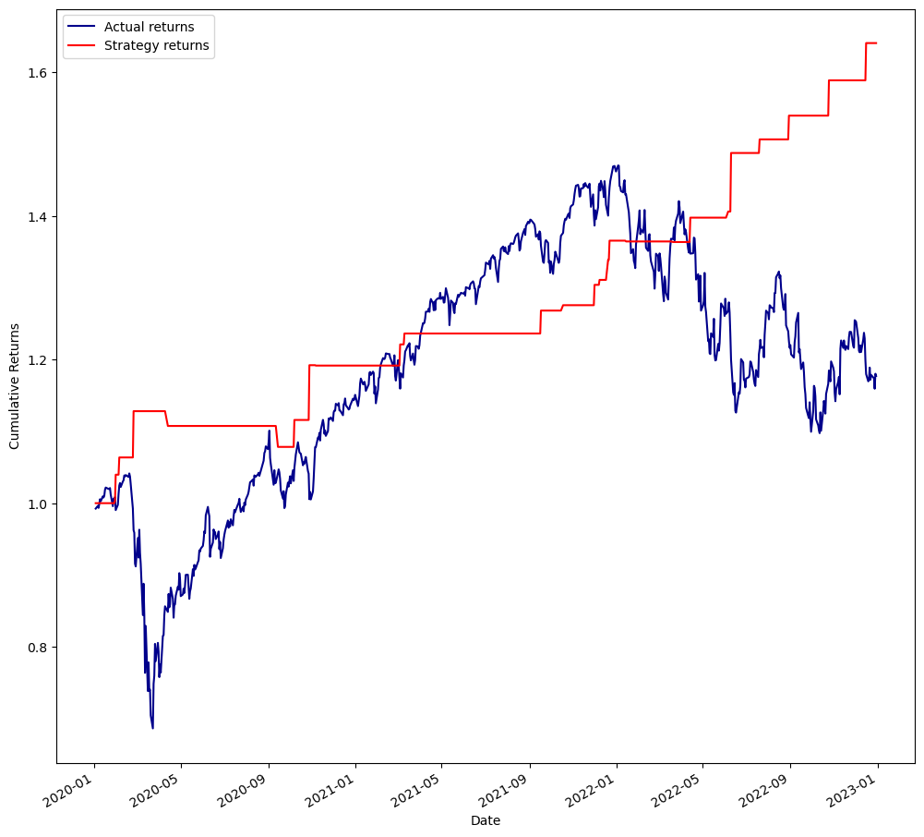
Backtest Result

Slide 15
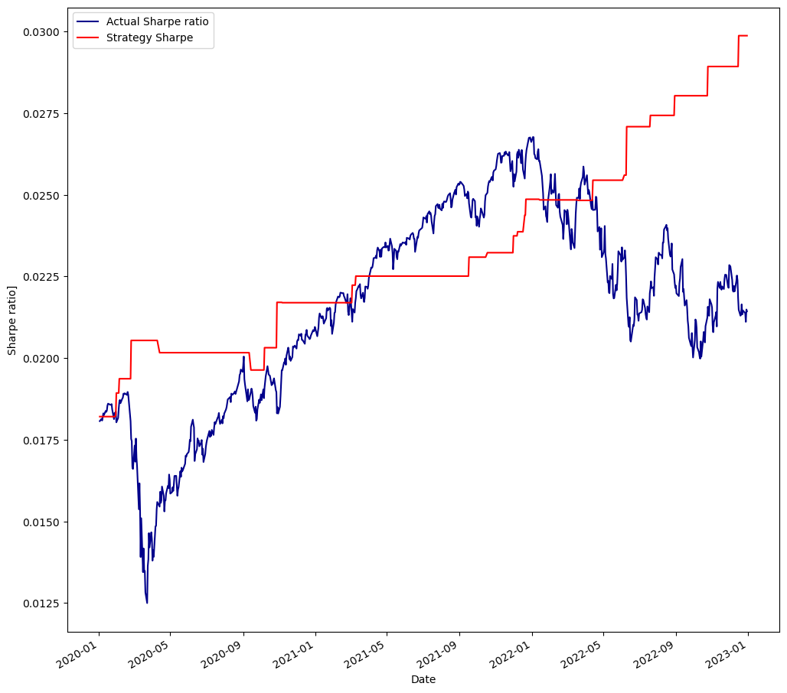
Sharpe ratio Result

Slide 16
Overview of the MACD and RSI Combination Strategy:
Moving on, let's explore the strategy that combines the Moving Average Convergence Divergence (MACD) with the Relative Strength Index (RSI).
MACD: The MACD is a versatile indicator that combines trend-following and momentum characteristics. By combining MACD with RSI, we can capture potential trend reversals identified by the MACD and further confirm them using the RSI's overbought and oversold signals.
RSI: As mentioned earlier, the RSI provides insights into overbought and oversold conditions, indicating potential reversals. Combining RSI with MACD helps validate the signals generated by the MACD and improves the precision of our trading decisions.
We will assess the performance of this combined strategy by analyzing historical data, evaluating key metrics, and comparing it with the EMA and RSI combination strategy.

Slide 17
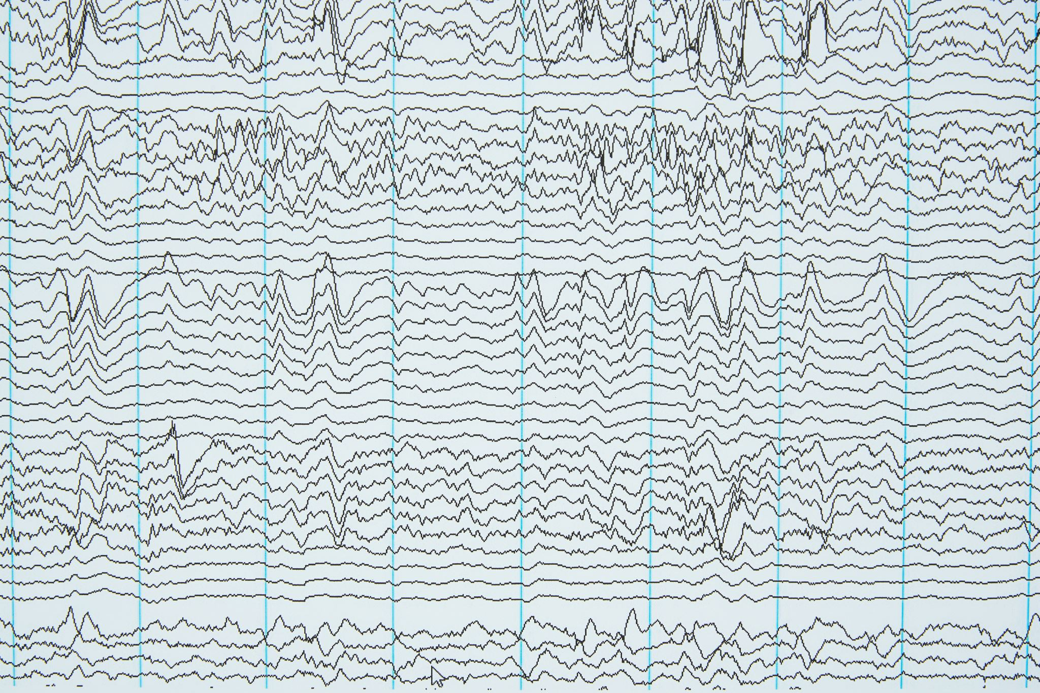
MACD Formula
Moving Average Convergence Divergence (MACD): MACD is a versatile indicator that combines trend-following and momentum characteristics. It consists of two lines: the MACD line, which represents the difference between two moving averages, and the signal line, which is a moving average of the MACD line. The MACD line crossing above or below the signal line is often considered a potential reversal signal.
It is calculated as follows:
MACD=12-Period EMA − 26-Period EMA
Signal line = 9- period EMA of MACD Line
Histogram = MACD line - Signal line

Slide 18
Defining First Entry and Exit Condition for MACD & RSI
Buy Entry: MACD line > Signal line.
Exit: The RSI is <= 50.
Sell Entry: MACD line < Signal line
Exit: The RSI is >= 50.

Slide 19

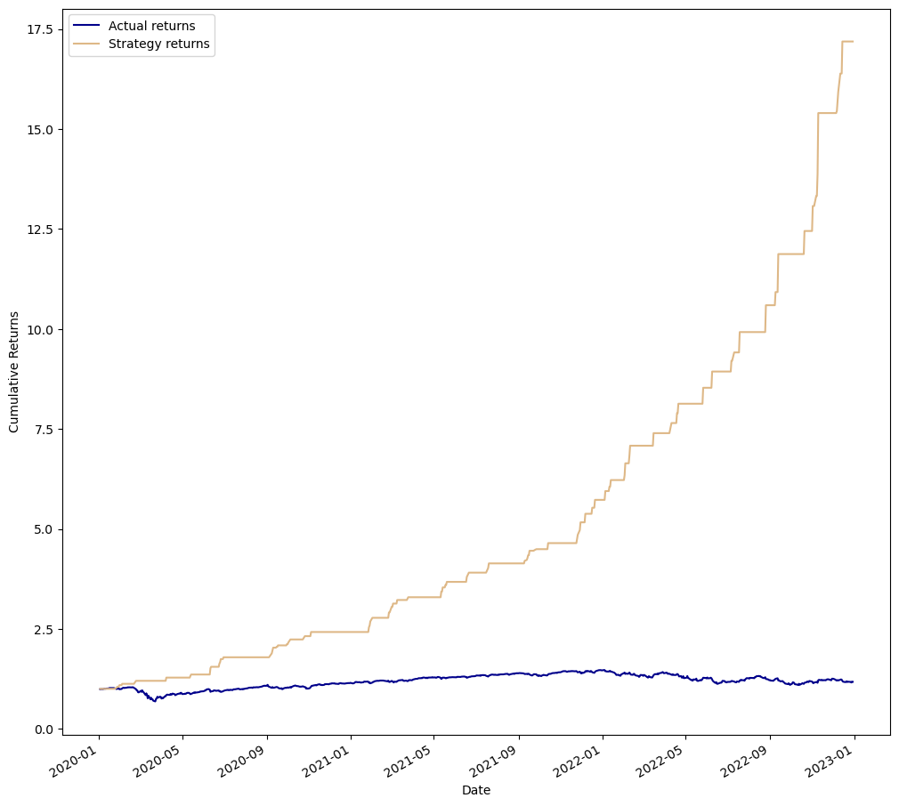
Backtest Result

Slide 20
Sharpe Ratio Result

Slide 21

Defining Second Entry and Exit Condition MACD & RSI
Buy Entry: MACD line > Signal line.
Exit: The RSI is <= 70.
Sell Entry: MACD line < Signal line
Exit: The RSI is >= 30.

Slide 22

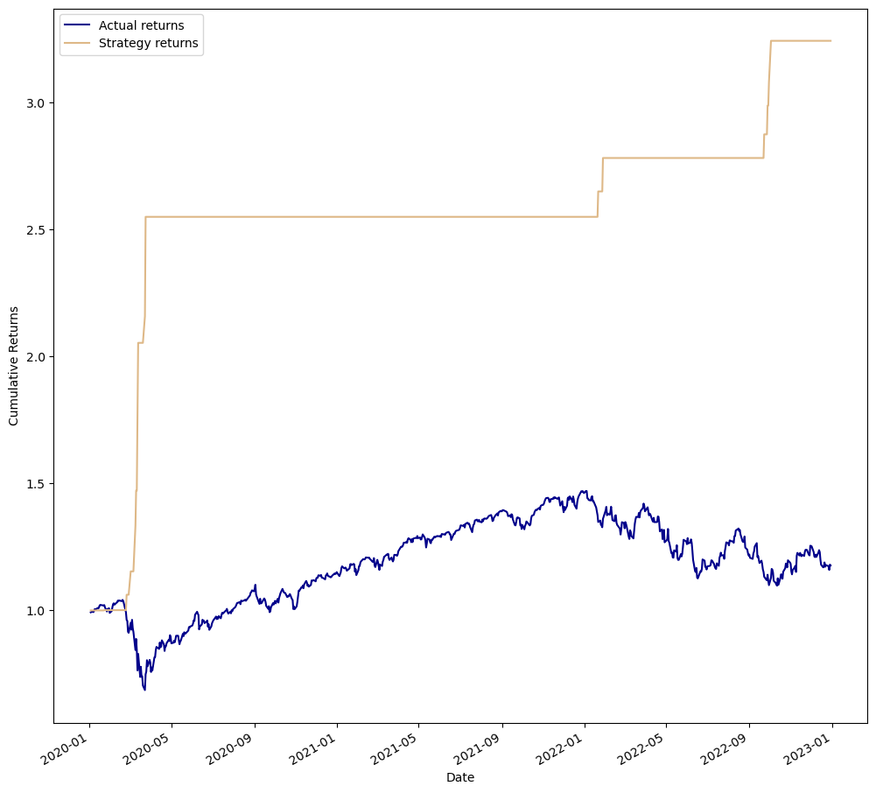
Backtest Result

Slide 23
Sharpe Ratio Result

Slide 24
Defining Third Entry and Exit Condition MACD & RSI
Buy Entry: MACD line > Signal line.
Exit: The RSI is <= 30.
Sell Entry: MACD line < Signal line
Exit: The RSI is >= 70.

Slide 25
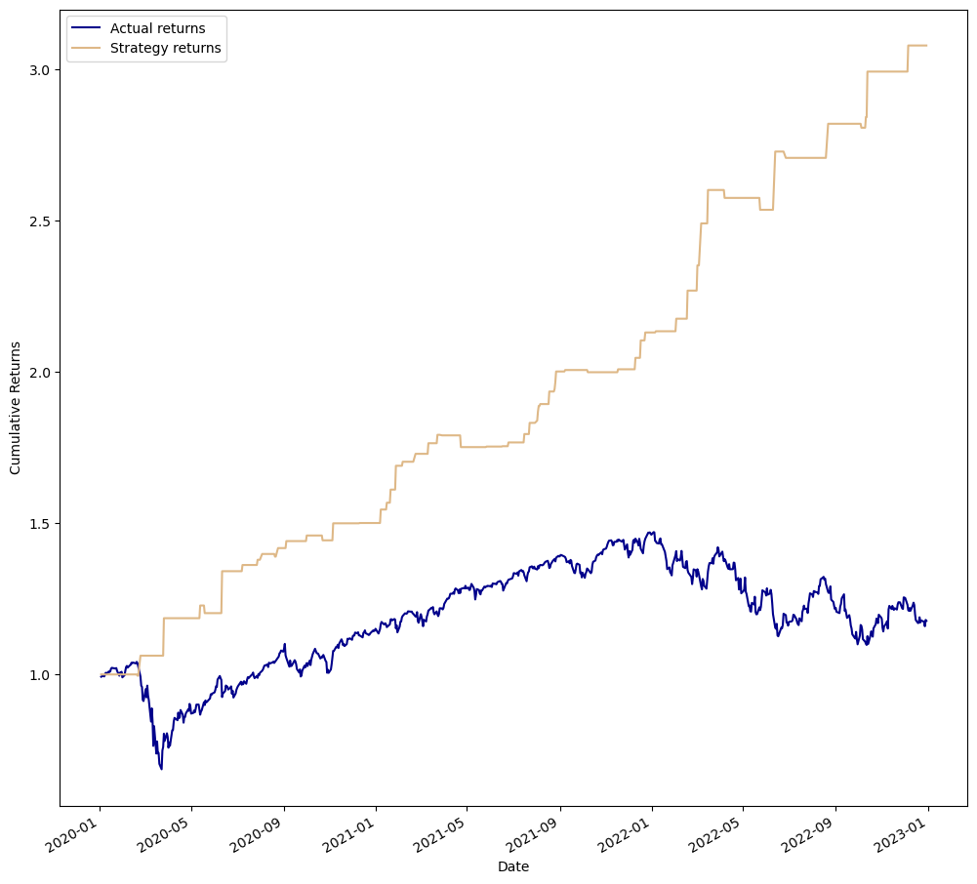
Backtest Result

Slide 26
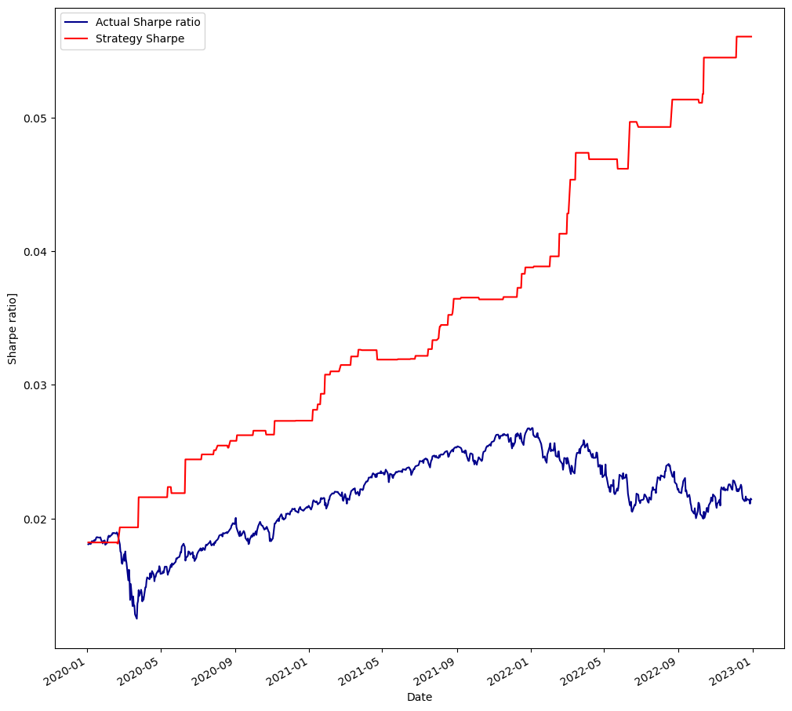
Sharpe Ratio Result

Slide 27
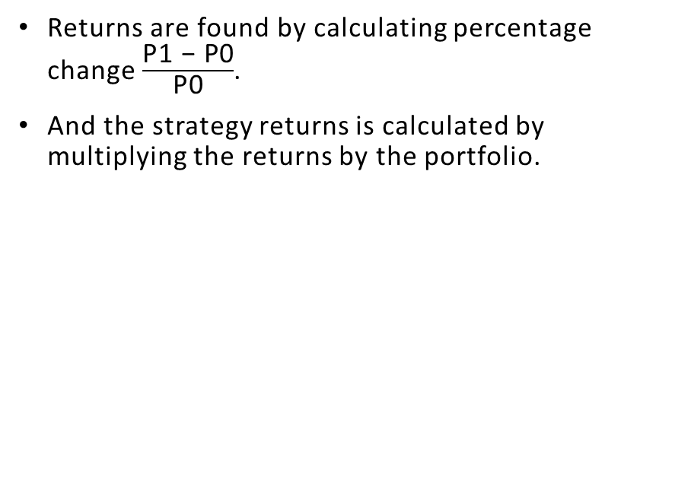
Returns Formula

Slide 28
Based on the analysis conducted with three different conditions, i found that the performance of the MACD and RSI combination strategy was generally superior to the EMA and RSI combination strategy.
Under the first condition, where the RSI benchmark of 50 was used as an exit condition, both strategies performed equally, generating impressive returns of 17.5 times the initial investment. This suggests that both strategies were effective in identifying potential trend reversals and generating profitable trading signals when the RSI reached the neutral territory.
Similarly, under the second condition, where the RSI benchmarks of 70 and 30 were used as exit conditions for selling and buying respectively, both strategies again performed equally, producing returns of 3.0 times the initial investment. This indicates that both strategies successfully identified overbought and oversold conditions signaled by the RSI, leading to profitable trades.
However, it is under the third condition, where the RSI benchmarks of 30 and 70 were used as exit conditions for buying and selling respectively, that a notable divergence in performance between the two strategies emerged.
The EMA and RSI combination strategy yielded a return of 1.6 times, while the MACD and RSI combination strategy produced a higher return of 3.0 times the initial investment. This suggests that the MACD strategy demonstrated better performance in capturing larger price movements and maximizing profit potential during trend reversals indicated by the RSI.
Findings

Slide 29
These findings highlight the significance of combining the MACD and RSI indicators to enhance trading strategies, particularly when using specific RSI benchmarks as exit conditions. The MACD and RSI combination strategy showed greater consistency and profitability, especially in conditions where the RSI signaled potential trend reversals.
It is important to remember that individual trading preferences, risk tolerance, and market dynamics should also be taken into account when implementing any trading strategy. Thorough backtesting, risk management techniques, and regular analysis are essential to ensure the strategies remain robust and aligned with personal goals and market conditions.
In summary, based on the analysis conducted, the MACD and RSI combination strategy has demonstrated stronger performance compared to the EMA and RSI combination strategy, particularly when utilizing specific RSI benchmarks as exit conditions for trading decisions.
Conclusion

